Slide 1


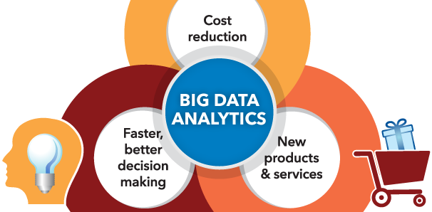
PROJECTS NAME: E-COMMERCE, A BEST APPROACH TO RANGE-AGGREGATE QUERIES IN BIG DATA ENVIRONMENT
PLATFORM : BIG DATA & HADOOP FRAMEWORK
CODING LANGUAGES: JAVA,PIG LATIN,HIVE.
DONE BY: JANAKIRAMAN

Slide 2
N
I
I
T
CONTENTS
INTRODUCTION
BIG DATA & HADOOP
E-COMMERCE
A BEST APPROACH TO RANGE-AGGREGATE QUERIES IN BIG DATA ENVIRONMENT
CONCLUSION
BIG DATA FOR BETTER SOLUTION

Slide 3
INTRODUCTION
N
I
I
T
Prerequisite
Java essentials
Servlets
JSP
MySQL
BIG DATA FOR BETTER SOLUTION

Slide 4
INTRODUCTION
N
I
I
T
Java essentials
Loops and Logics
OOP Concepts
Servlets
Understating about servlets
BIG DATA FOR BETTER SOLUTION

Slide 5
INTRODUCTION
N
I
I
T
JAVASERVER PAGES
Simple web application using JSP
MySQL
Basic queries in MySQL
Working with GITHUB
BIG DATA FOR BETTER SOLUTION

Slide 6


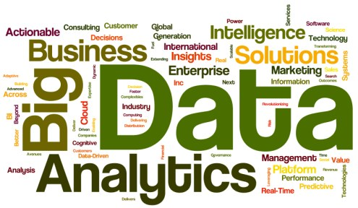


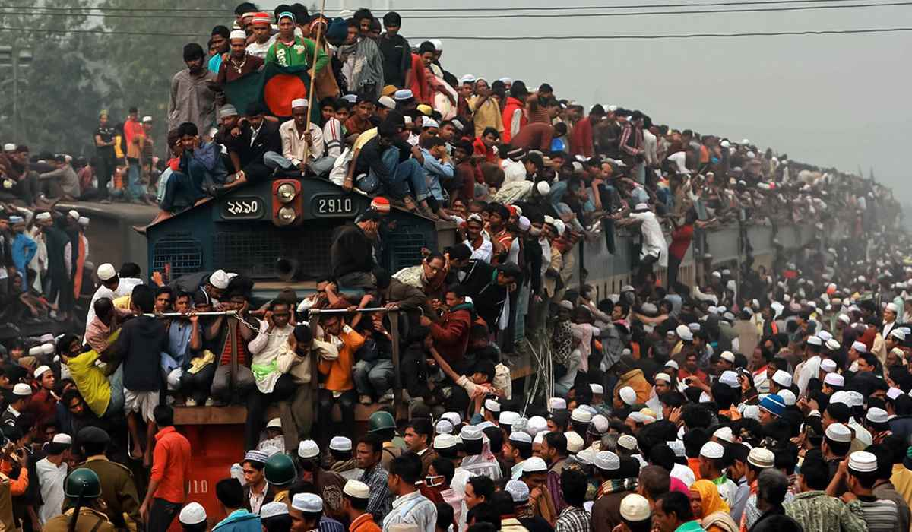
BIG DATA & HADOOP
N
I
I
T
BIG DATA FOR BETTER SOLUTION

Slide 7
BIG DATA & HADOOP
N
I
I
T
BIG DATA
Classified by…
Volume
Velocity
Variety
Veracity
BIG DATA FOR BETTER SOLUTION

Slide 8
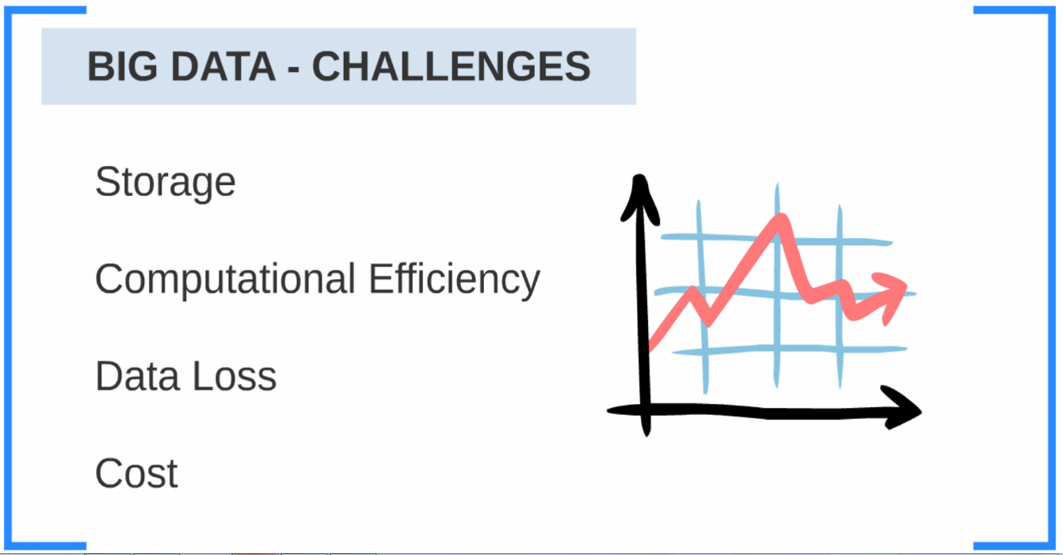
N
I
I
T
BIG DATA FOR BETTER SOLUTION

Slide 9
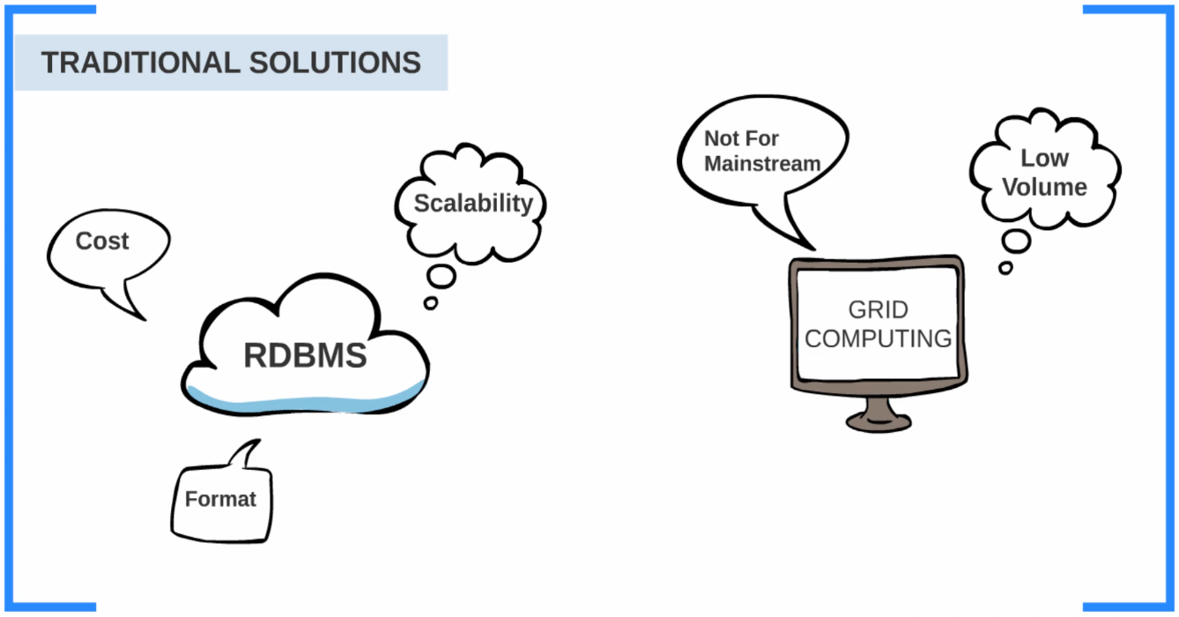
N
I
I
T
BIG DATA FOR BETTER SOLUTION

Slide 10
N
I
I
T
HADOOP
BIG DATA FOR BETTER SOLUTION

Slide 11
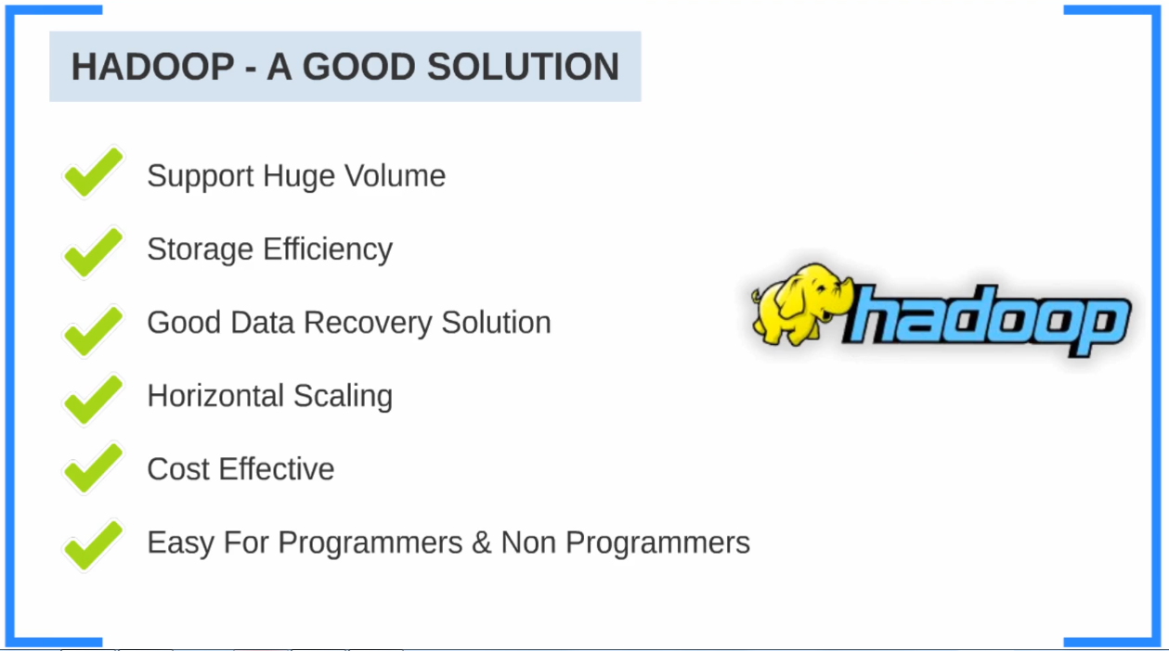
N
I
I
T
BIG DATA FOR BETTER SOLUTION

Slide 12
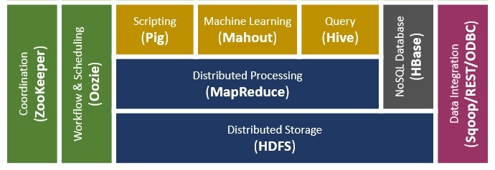
N
I
I
T
BIG DATA FOR BETTER SOLUTION

Slide 13
N
I
I
T
(MAPREDUCE)
DISTRIBUTED PROCESSING
(HDFS)
DISTRIBUTED STORAGE
BIG DATA FOR BETTER SOLUTION

Slide 14
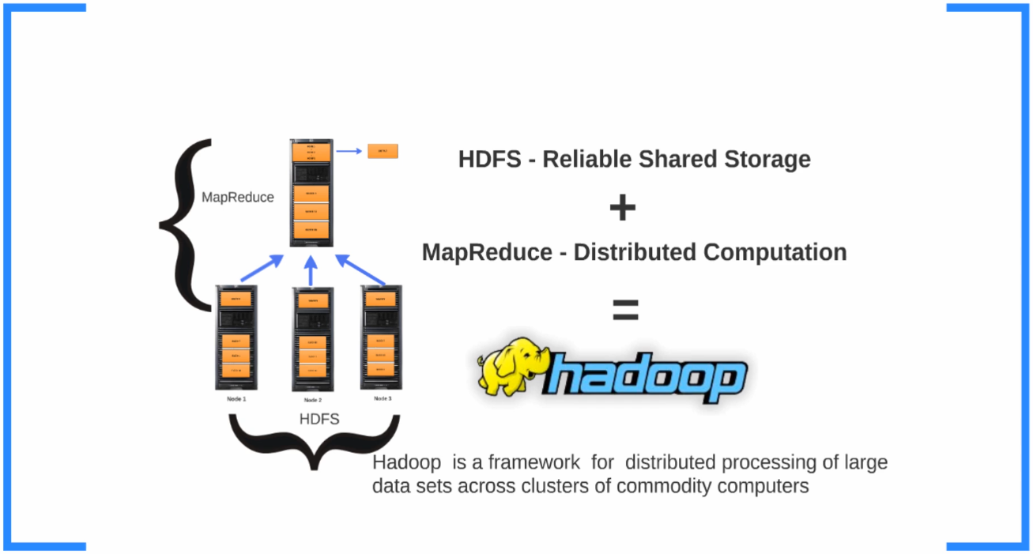
N
I
I
T
BIG DATA FOR BETTER SOLUTION

Slide 15
N
I
I
T
HADOOP DISTRIBUTED FILE SYSTEM
BIG DATA FOR BETTER SOLUTION

Slide 16
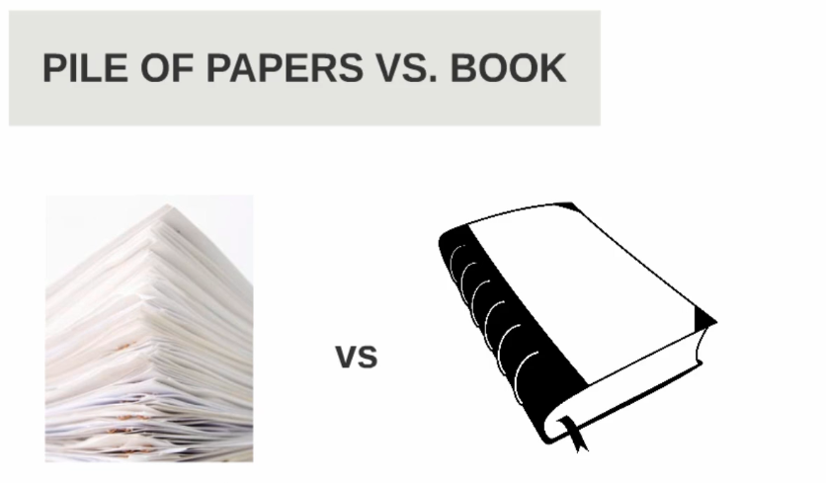
N
I
I
T
BIG DATA FOR BETTER SOLUTION

Slide 17
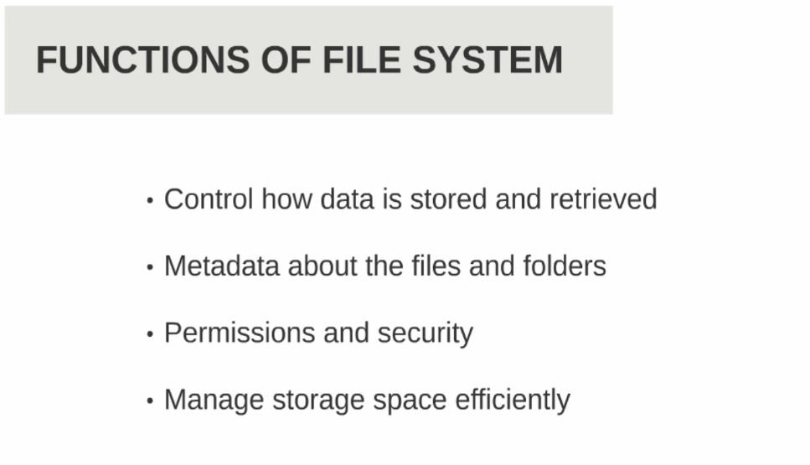
N
I
I
T
BIG DATA FOR BETTER SOLUTION

Slide 18
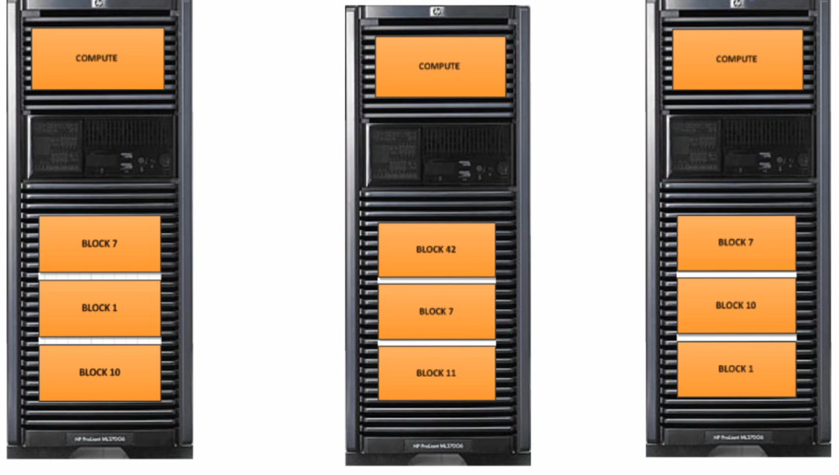
N
I
I
T
BIG DATA FOR BETTER SOLUTION

Slide 19
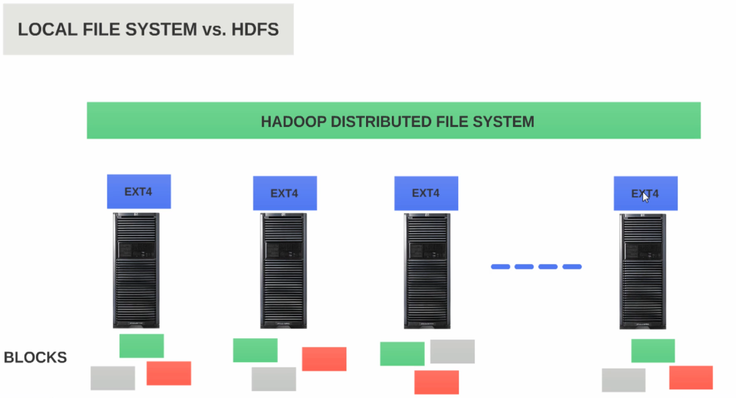
N
I
I
T
BIG DATA FOR BETTER SOLUTION

Slide 20
N
I
I
T
MASTER
SLAVE
SLAVE
SLAVE
SLAVE
SLAVE
BIG DATA FOR BETTER SOLUTION

Slide 21
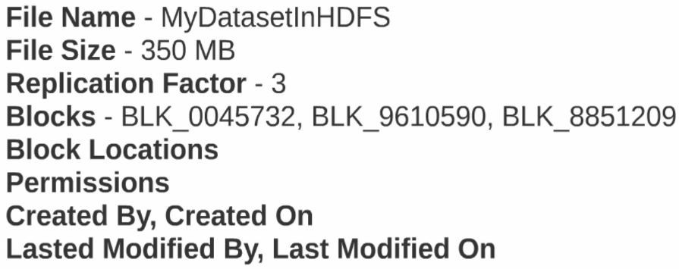
N
I
I
T
BIG DATA FOR BETTER SOLUTION

Slide 22
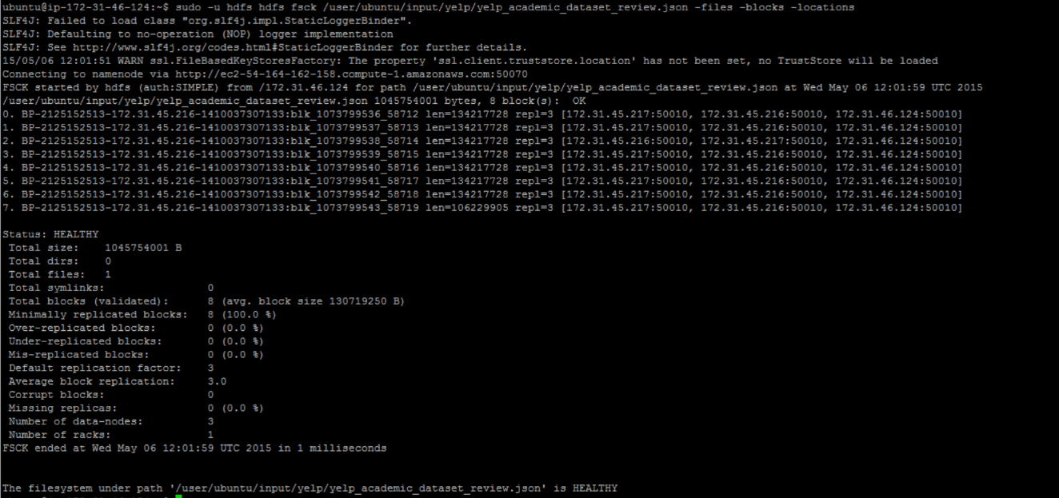
N
I
I
T
BIG DATA FOR BETTER SOLUTION

Slide 23
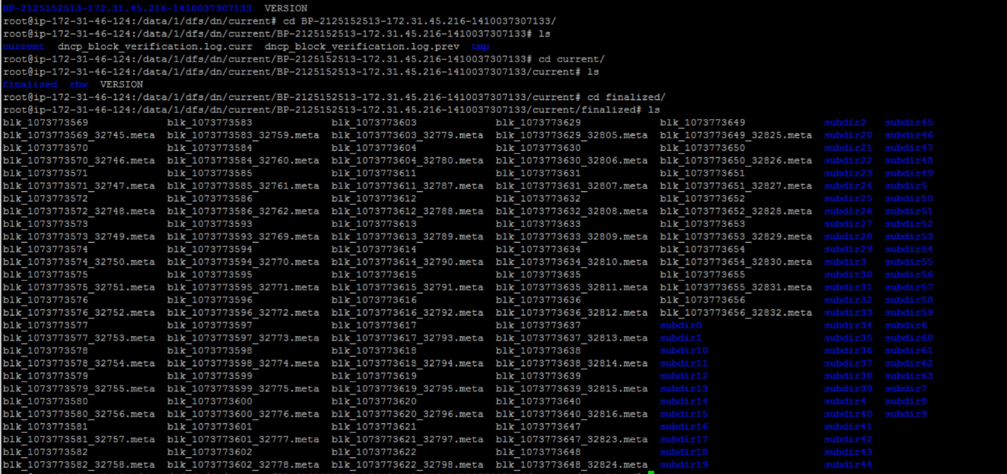
N
I
I
T
BIG DATA FOR BETTER SOLUTION

Slide 24
N
I
I
T
MAPREDUCE
BIG DATA FOR BETTER SOLUTION

Slide 25
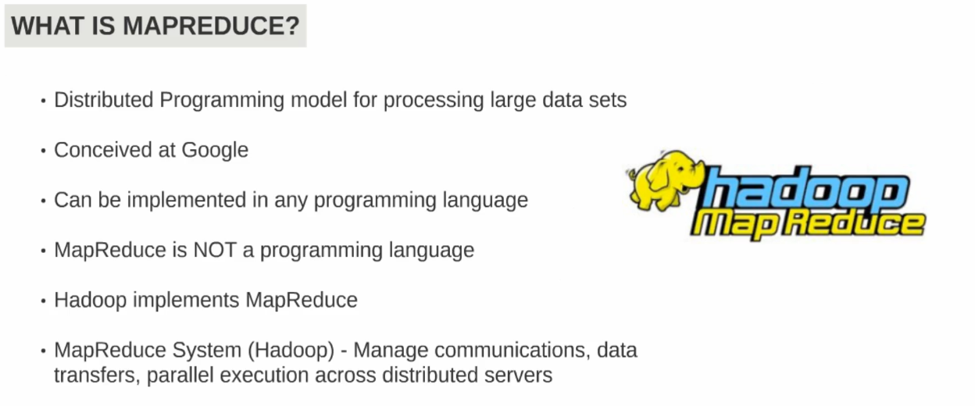
N
I
I
T
BIG DATA FOR BETTER SOLUTION

Slide 26
N
I
I
T
E-COMMERCE
E-commerce (electronic commerce or EC) is the buying and selling of goods and services,
or the transmitting of funds or data, over an electronic network, primarily the internet.
These business transactions occur either as business-to-business, business-to-consumer,
consumer-to-consumer or consumer-to-business.
BIG DATA FOR BETTER SOLUTION

Slide 27

N
I
I
T
BIG DATA FOR BETTER SOLUTION

Slide 28

N
I
I
T
BIG DATA FOR BETTER SOLUTION

Slide 29

N
I
I
T
BIG DATA FOR BETTER SOLUTION

Slide 30
A BEST APPROACH TO RANGE-AGGREGATE QUERIES IN BIG DATA ENVIRONMENT
N
I
I
T

Slide 31
N
I
I
T
CONCLUSION
BIG DATA FOR BETTER SOLUTION

Slide 32
N
I
I
T
ANY QUERY?

Slide 33
N
I
I
T
THANK YOU..,

